Slide 1
AQS Conference 2012
Integrating United States
And
Canadian Air Monitoring Data
Bill Sukloff
Computer Systems Analyst
Environment Canada

Slide 2
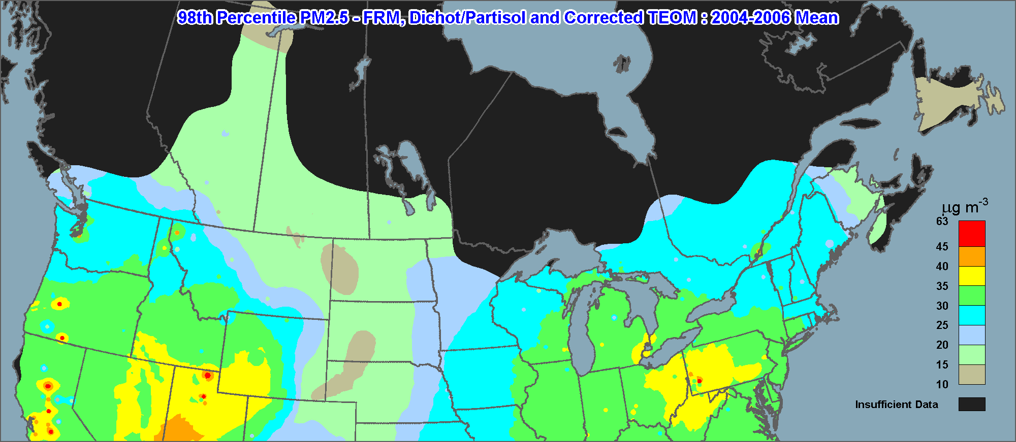
Reports and Publications
Source: 2012 Canadian Smog Science Assessment (Environment Canada / Health Canada)
Notes:
The spatial pattern of ambient PM2.5 levels across the country in 2004–2006 (Figure 1), as defined by the
Canada-wide Standard metric, shows southern Ontario and southern Quebec having the highest concentrations
(>25 μg m-3). This area is also part of a larger high concentration airshed that encompasses all of
the eastern U.S. The highest levels in Canada over the 2004–2006 period occurred in the Great Lakes
region, particularly in southwestern Ontario where densely populated urban sites experienced levels
above the Canada-wide Standard. Across southern Quebec and eastern Ontario, PM2.5 concentrations
were generally below the Canada-wide Standard target, with the exception of some specific communities
influenced by local industries and large urban centres, highlighting the potential for emissions to lead to
localized high levels. There are uncertainties in the exact levels and local details of the spatial distribution of
PM2.5 (Figure 1) over some areas of the country because of a lack of PM2.5 measurement sites. However,
on a broad scale, Figure 1 provides a general picture of the spatial pattern.

Slide 3
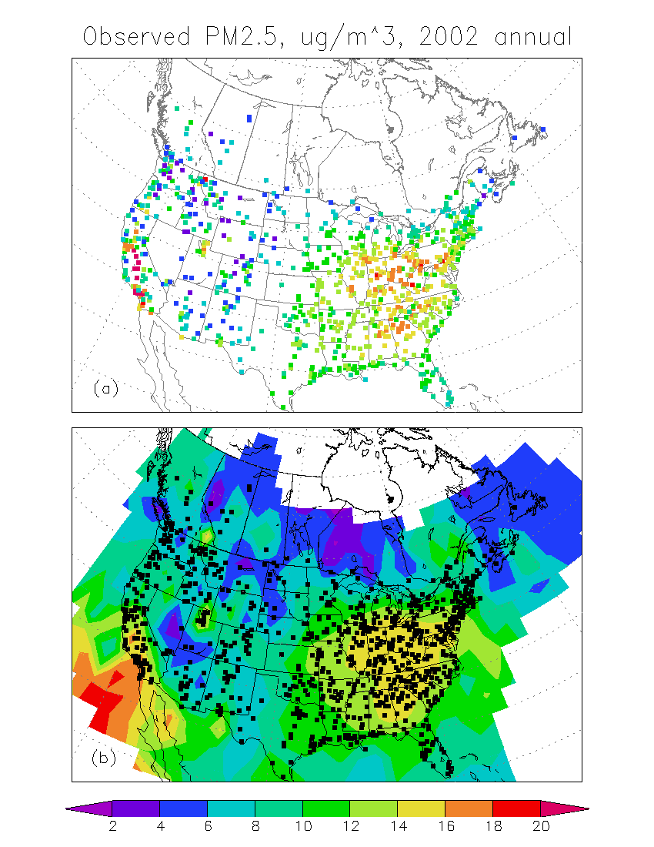
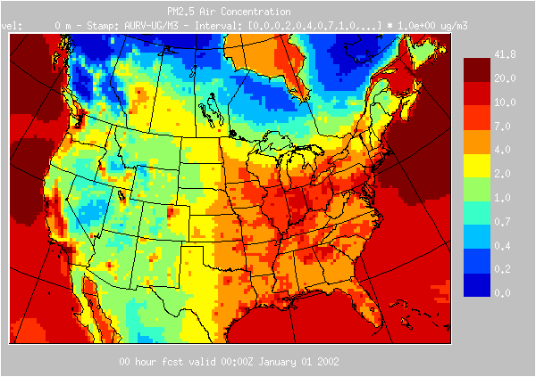
Model Evaluation

Slide 4
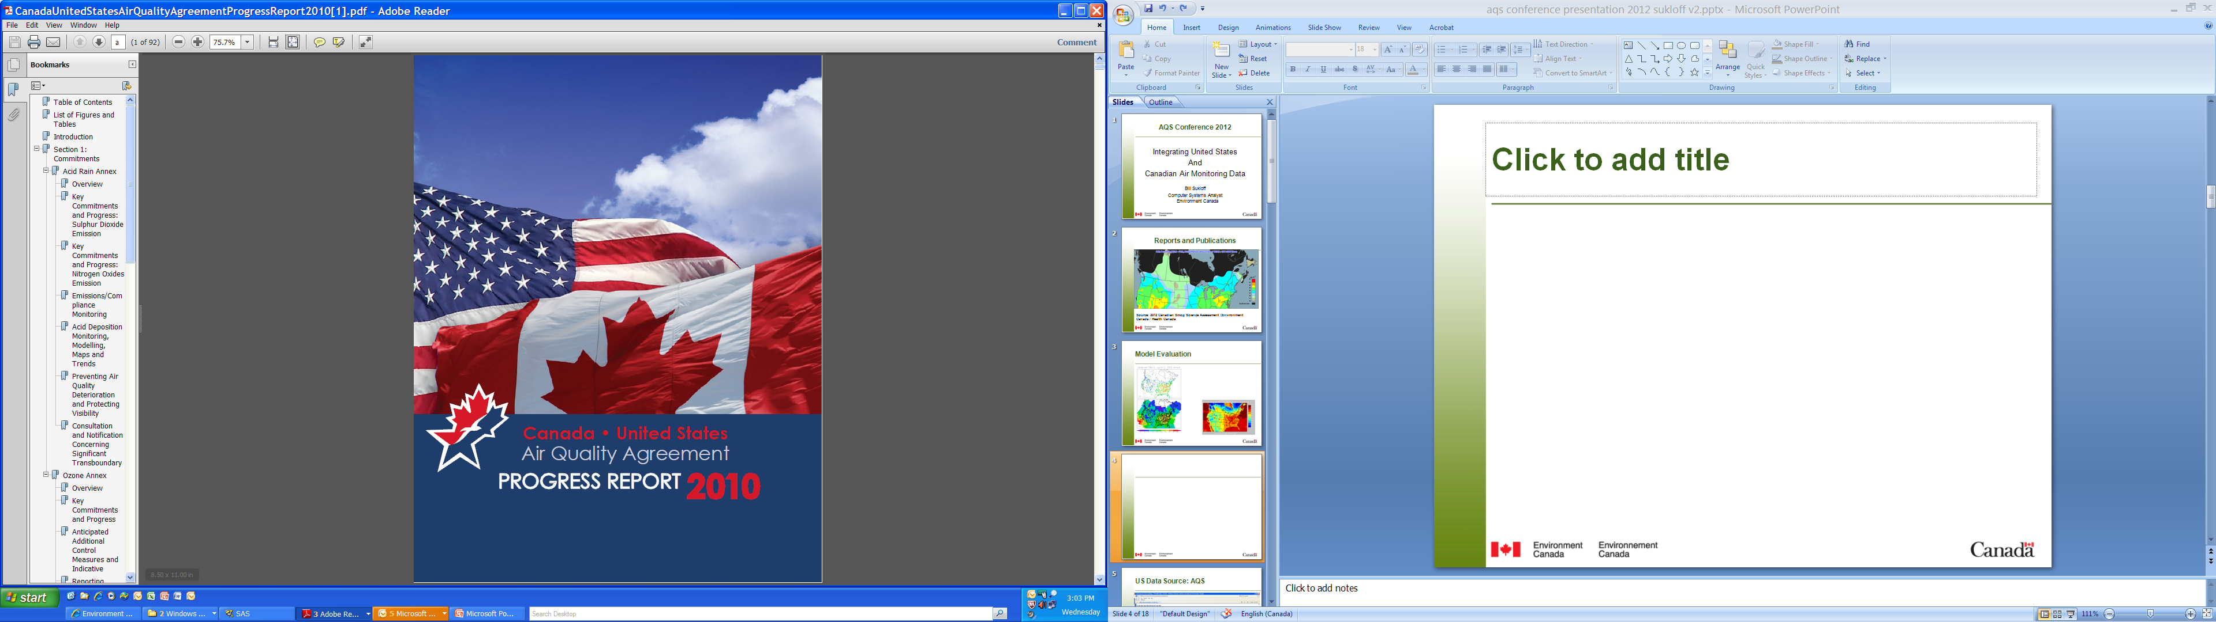
International Agreements
Notes:
The three maps indicate that wet sulphate deposition
is consistently highest in eastern North America
around the lower Great Lakes, with a gradient following
a southwest-to-northeast axis running from the
confl uence of the Mississippi and Ohio rivers through
the lower Great Lakes. The patterns for 1990, 2000
and 2007 illustrate that signifi cant reductions occurred
Acid Deposition Monitoring, Modelling, Maps and Trends
Figure 4. 1990 Annual Wet
Sulphate Deposition
Source: National Atmospheric Chemistry (NAtChem) Database
(www.msc-smc.ec.gc.ca/natchem/index_e.html) and the National
Atmospheric Deposition Program
Figure 5. 2000 Annual Wet
Sulphate Deposition
Source: National Atmospheric Chemistry (NAtChem) Database
(www.msc-smc.ec.gc.ca/natchem/index_e.html) and the National
Atmospheric Deposition Program
Figure 6. 2007 Annual Wet
Sulphate Deposition
Source: National Atmospheric Chemistry (NAtChem) Database
(www.msc-smc.ec.gc.ca/natchem/index_e.html) and the National
Atmospheric Deposition Program
10
Progress Report 2010
in wet sulphate deposition in both the eastern United
States and much of eastern Canada. By 2000, the
region receiving greater than 28 kg/ha/yr (kilograms
per hectare per year) of sulphate wet deposition had
decreased to a small area near the southern shore
of Lake Erie, and had disappeared completely in
2007. The regions receiving more than 20 kg/ha/yr of
sulphate wet deposition in 1990 had also decreased
markedly by 2007 to several small areas mainly in the
states of Pennsylvania, New York and Indiana. The
wet sulphate deposition reductions are considered
to be directly related to decreases in SO2 emissions
in both Canada and the United States. The emission
reductions are outlined in the Key Commitments and
Progress: Sulphur Dioxide Emission Reductions section
beginning on page 4 of this report. The patterns of
wet nitrate deposition (Figures 7 through 9) show a
similar southwest-to-northeast axis, but the area of
highest nitrate deposition is north of the region with
the highest sulphate deposition.

Slide 5
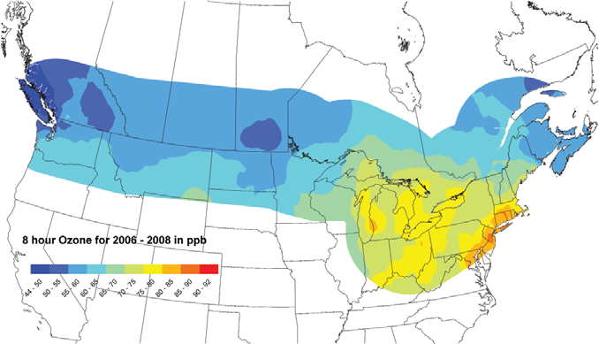
Publications
Ozone Concentrations along the Canada–U.S. Border
(Three-Year Average of the Fourth-highest Daily Maximum 8-hour Average), 2006–2008
Notes:
About 80% of the population in Canada lives within 150 kilometres (93 mi) of the United States border

Slide 6
Data Sources: Particulate Matter & Toxics Networks
Network | Sampling Period | Start & End Time | STP | Blank Corrected | Flow Rate | Date | Size cut
AIRMoN | 7days | 0900-0900 | STP (21° C) | yes | 3l/min | 1984 | ND
AMODES | 24hr | Var. | STP (25° C) | yes | 20l/min | 1988 - 1990 | ND
AQS | 24hr | Var. | Var. | yes & no |  | 1995 | 2.5µm, 10µm
APIOS-C | 28days | 0800-0800 | Amb. | no | 2l/min | 1981 - 1993 | ND
APIOS-D | 24hr | 0800-0800 | Amb. | no | 20l/min | 1980 - 1993 | ND
CAACP | 7 days | Var. | STP ( 0°C) | yes | 1m**3/min | 1980 | ND
CAAMP | 24hr | 0800-0800 | STP ( 0°C) | no | 16.7l/min | 1992 - 1996 | 2.5µm, 10µm
CAMNet | 24hr | Var. | Amb. | no | 0.75/min | 1995 | ND

Slide 7
Data Sources: Particulate Matter & Toxics Networks
Network | Sampling Period | Start & End Time | STP | Blank Corrected | Flow Rate | Date | Size cut
CANCP | 7 days | 1100-1100 | STP (25°C) | no | 1.1m**3/min | 1993 | 10µm
CAPMoN | 24hr | 0800-0800 | STP ( 0°C) | yes | 25l/min | 1979 | ND
CASTNet | 7 days | 0800-0800 | STP (25°C) | yes | 1.5l/min (E), 3l/min (W) | 1987 | ND
FPNT | 24hr | 0800-0800 | STP (25°C) | no | 8.8l/min | 1988 - 1990 | 2.5µm
GAViM | 24hr | 0001-2359 | Amb. | no | 22.9l/min, | 1994 - 2001 | 2.5µm
IADN-A | 24hr | 0800-0800 | STP ( 0°C) | yes & no |  | 1988 | ND, 10µm
IMPROVE | 24hr | 0000-0000 | Amb. | no | 22.8l/min, 16.9l/min | 1988 | 2.6µm, 10µm
NAPS | 24hr | 0000-0000 or 0800-0800 | STP (25°C) | no | 16.7l/min. | 1992 | 2.5µm
Notes:
Improve: PM Fine Speciation
PAMS: Voc

Slide 8
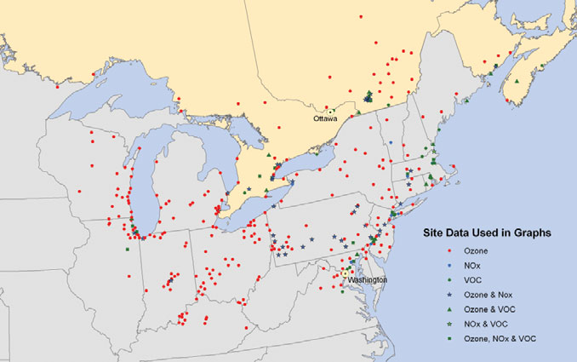
Data Sources: Example
Network of Monitoring Sites Used to Create Graphs
of Ambient Ozone, NOx and VOC Levels

Slide 9
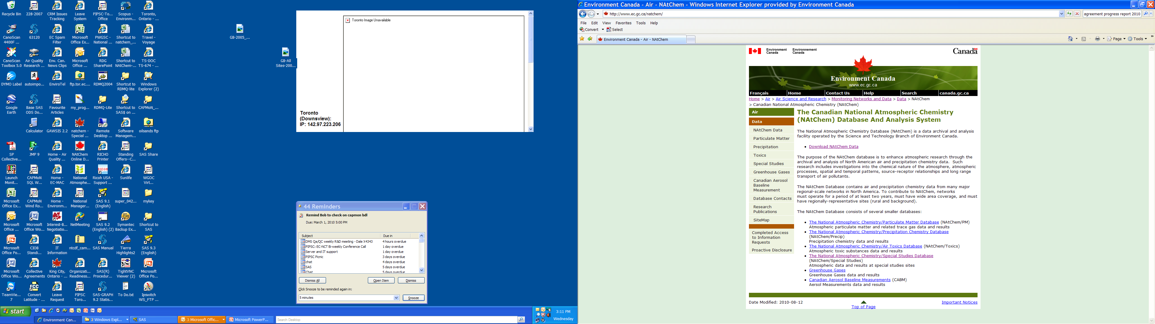
NAtChem
Notes:
The National Atmospheric Chemistry Database (NAtChem) is a data archival and analysis facility operated by the Science and Technology Branch of Environment Canada.
The purpose of the NAtChem database is to enhance atmospheric research through the archival and analysis of North American air and precipitation chemistry data. Such research includes investigations into the chemical nature of the atmosphere, atmospheric processes, spatial and temporal patterns, source-receptor relationships and long range transport of air pollutants.
The NAtChem Database contains air and precipitation chemistry data from many major regional-scale networks in North America. To contribute to NAtChem, networks must operate for a period of at least two years, must have wide area coverage, and must have regionally-representative sites (rural and background).

Slide 10
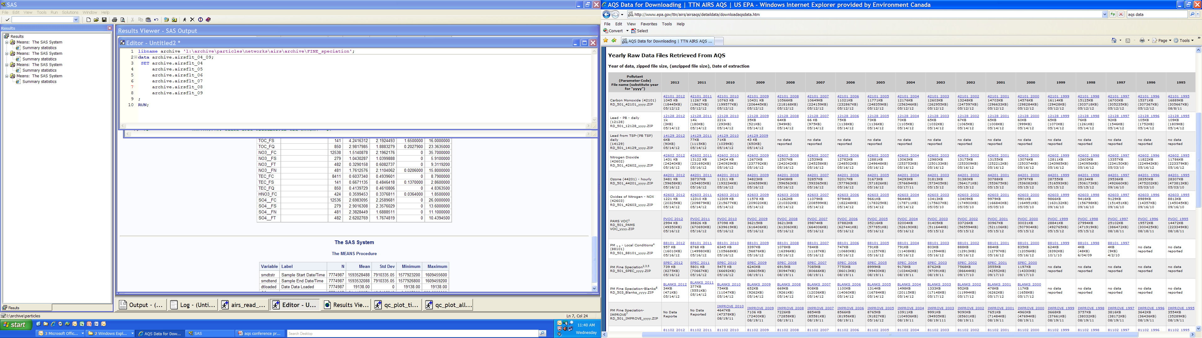
US Data Source: AQS

Slide 11
Read AQS Data
INFILE "&rawfile.\*.txt" lrecl=300 delimiter="|" missover dsd;
INPUT trantype $
actcode $
state
county $
site $ @;

Slide 12
Read AQS Data
…
SELECT;
WHEN (trantype="RD") DO;
INPUT parameter_code :$char5.
poc :$char1.
sampdur :$char1.
unit_code :$char3.
method_code :$char3.
date :yymmdd10.
start :time5.
sampval
nullcode :$char2.
collfreq :$char1.
altmpid :$char1.
qual1: $char2. qual2: $char2. qual3: $char2. qual4: $char2. qual5: $char2.
qual6: $char2. qual7: $char2. qual8: $char2. qual9: $char2. qual10: $char2.
methdl
uncert ;
…

Slide 13
Read AQS Data
SELECT;
WHEN(sampdur EQ '1') DO; * Hourly;
smdtend = smdtstr + 3600;
END;
WHEN(sampdur EQ 'H') DO; * 5 minute ;
smdtend = smdtstr + 300;
END;
WHEN(sampdur EQ '7') DO; * Daily;
smdtend = smdtstr + 86400;
END;
OTHERWISE DO;
IF sampdur NE _prev_sampdur
THEN PUT 'WARNING: Excluding non-standard sampling period: '
sampdur= 'hrs, ' orgstnid= method_code = ;
DELETE;
END;
END; * end select;
…

Slide 14
Assign Metadata Fields
Parameter code & description
Method code & Sample analysis description
Unit code & description
Sample duration
Sample collection description
Method detectable limit
Unit and/or STP conversion: description
Unit and/or STP conversion: equation / constant
NAtChem variable name / unit

Slide 15
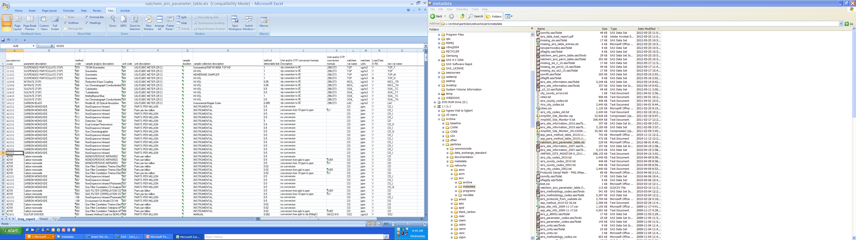
Assign Metadata and Transform Data

Slide 16
Map to NAtChem Metadata Fields
Station ID
Sample start date/time (local standard time)
Sample end date/time
Variable name
Instrument type
Sampling media or principle
Coating or absorbing solution / media
Humidity or temperature control
… continued

Slide 17
Map to NAtChem Metadata Fields
Inlet type
Size cut
Sample analysis method
Solubility type
Standard temperature and pressure
Blank correction
Value
NAtChem flag

Slide 18
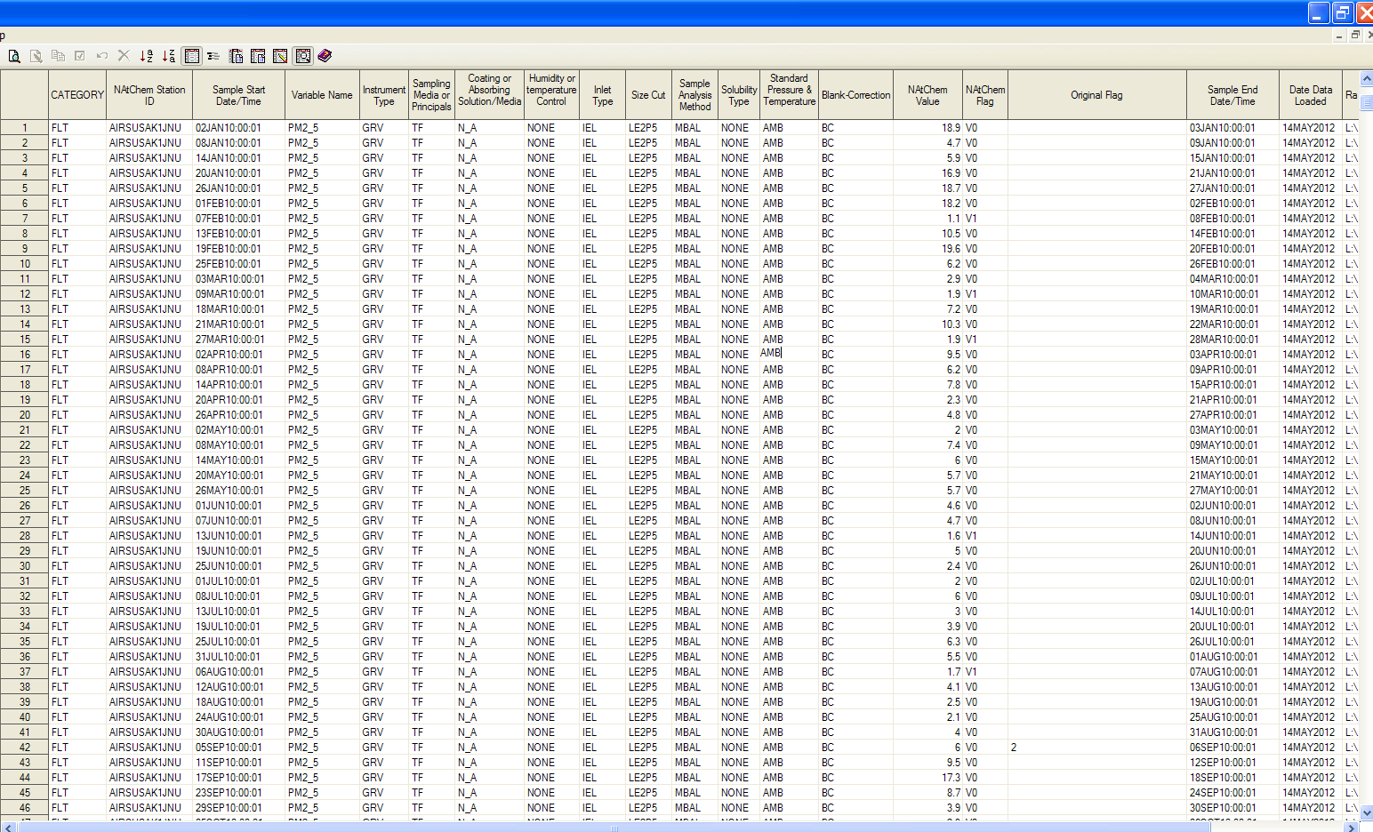
NAtChem Database

Slide 19
NAtChem Database Facility
Network
Quality Controlled
Information
Data
Original Data
Originator
Station
Conversion
Information
Program
Measurement
Characteristics
Quality Assurance
Web Site
NAtChem
Archive
Summary Statistics
Archive
Analysis
Notes:
Read program for each network / data format
Mapping of
Qa/qc checks include

Slide 20
NAtChem Database
Read program for each data source
Standard names, units, date/time, metadata
Combining of data
  Select parameters
  Determine metadata criteria
  Obtain latest version of data from source
  Read data into NAtChem
Perform analysis
Notes:
Time zone: local standard time.
Time: start, end, or middle of sampling period? This apparently simple piece of metadata has tripped up data users, including scientists using their own data, more times than we would like to mention. NAtChem records the start and end of the sampling interval for each sample. The data exchange files include two sets of times: local standard time and Coordinated Universal Time.
Mapping to standardized parameter name, units, and STP
AQS provides the needed metadata. For other data sources it can take a significant amount of time to determine the metadata entries for each parameter.
Data versioning must be considered. Each time we use AQS data we check for updates on the AQS web site.
Where available we obtain data sets where data below the detection limit have not been censored.

Slide 21
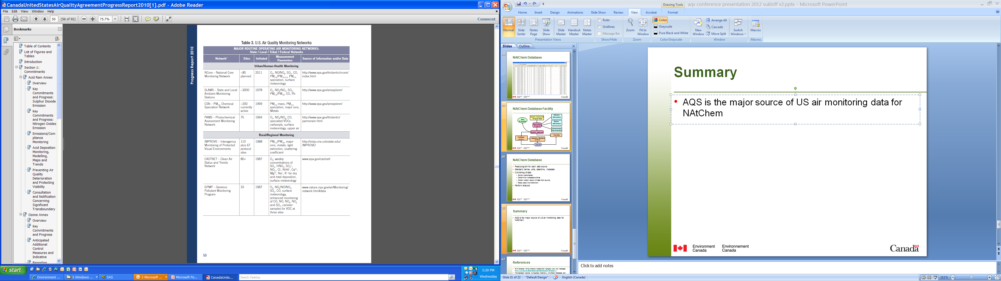
Integrating US and Canadian air monitoring data: sources

Slide 22
Summary
The key to successfully integrating US and Canadian air monitoring data is in the metadata.
  Taxonomies
  Key characteristics
  Quality assurance
  Data versioning

Slide 23
References
The Canadian National Atmospheric Chemistry (NAtChem) Database and Analysis Facility (www.ec.gc.ca/natchem)
2012 Canadian Smog Science Assessment Highlights and Key Messages (http://www.ec.gc.ca/air/default.asp?lang=En&n=72F82C27-1)
2010 Canada—United States Air Quality Agreement: Progress Report ISDM-444 (http://www.ec.gc.ca/Publications/default.asp?lang=En&xml=4B98B185-7523-4CFF-90F2-5688EBA89E4A)
AQS Data: http://www.epa.gov/ttn/airs/airsaqs/detaildata/downloadaqsdata.htm

